Slide 1
A SUSTAINABLE DEVELOPMENT PLAN FOR PARKVIEW GARDENS
TRAFFIC COMMISSION PRESENTATION 01
UNIVERSITY CITY, MISSOURI
H3 STUDIO
OCTOBER 12, 2011

Slide 2
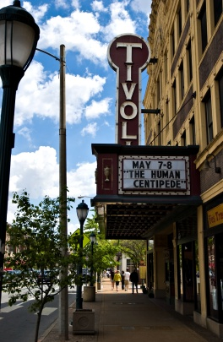
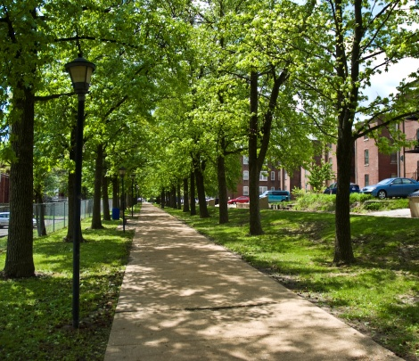
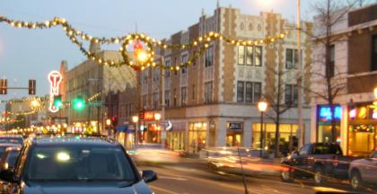
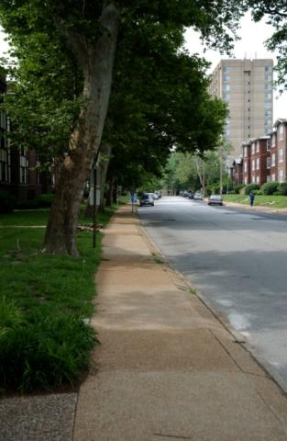
AGENDA
INTRODUCTION
PLANNING PROCESS
Project Boundaries
Objective and Project Inception
Partners, Advisors & Consultants
Scope of Services
Key Work Products
Project Schedule
PUBLIC WORKSHOP #1 SUMMARY
PUBLIC WORKSHOP #2 SUMMARY
DEVELOPMENT PROGRAM & MASSING PREFERRED OPTION
NEXT STEPS…
QUESTIONS & ANSWERS

Slide 3
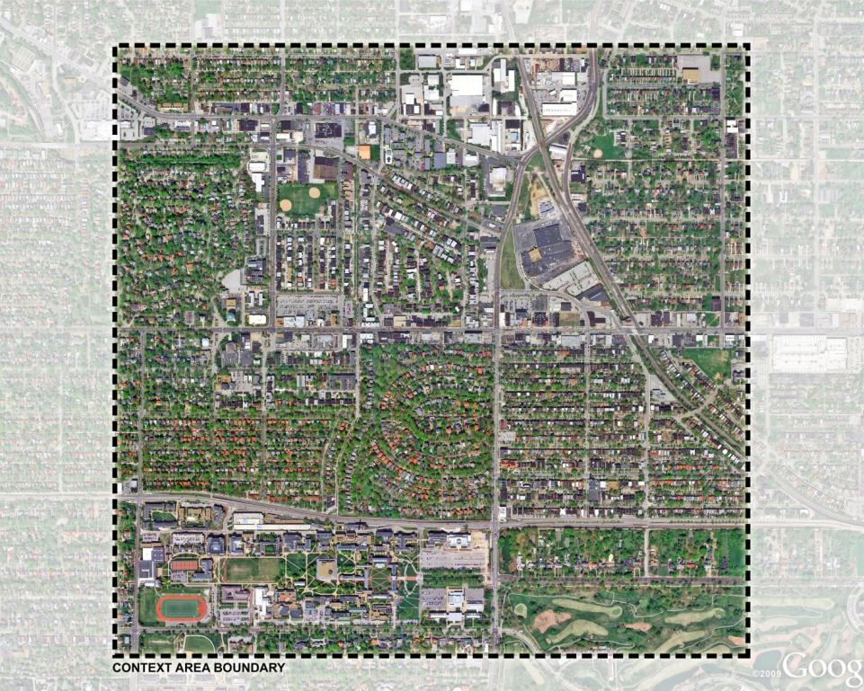
BOUNDARIES
CONTEXT AREA
Etzel Avenue to the North
Forsyth Boulevard to the South
Hamilton Avenue to the East
Big Bend Boulevard to the West

Slide 4
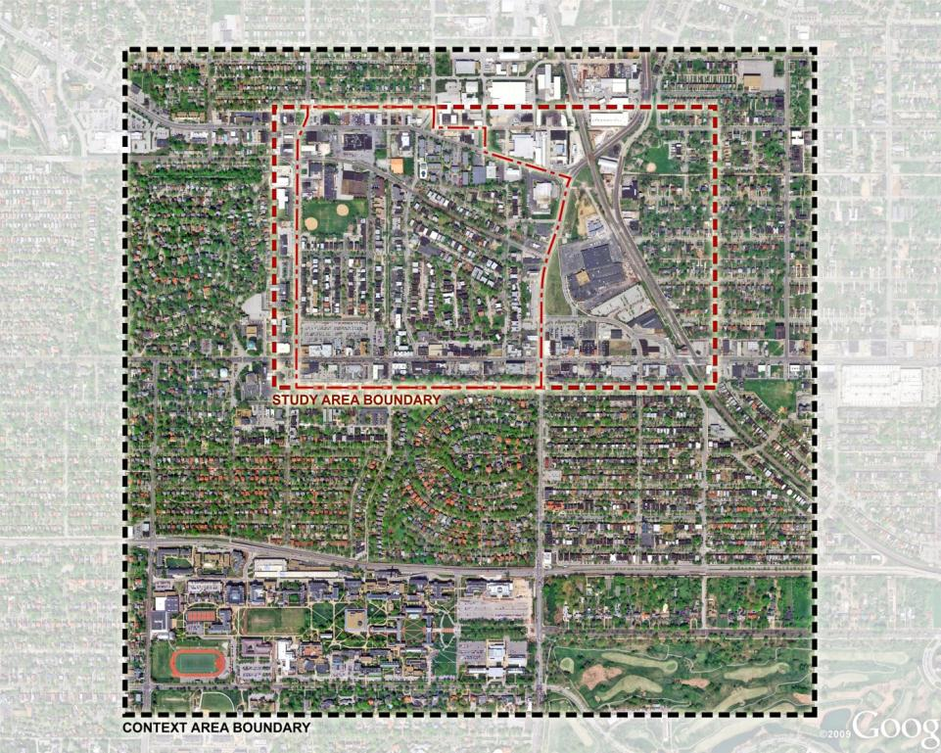
BOUNDARIES
CONTEXT AREA
STUDY AREA
Olive Boulevard to the North
Delmar Boulevard to the South
Hodiamont Avenue to the East
Kingsland Avenue to the West
DETAIL PLANNING AREA
Olive Boulevard to the North
Delmar Boulevard to the South
N. Skinker Boulevard to the East
Kingsland Avenue to the West

Slide 5
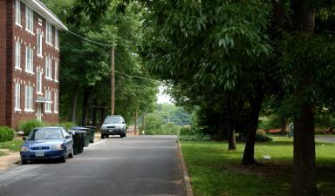
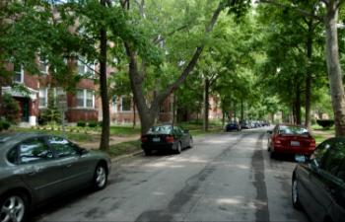
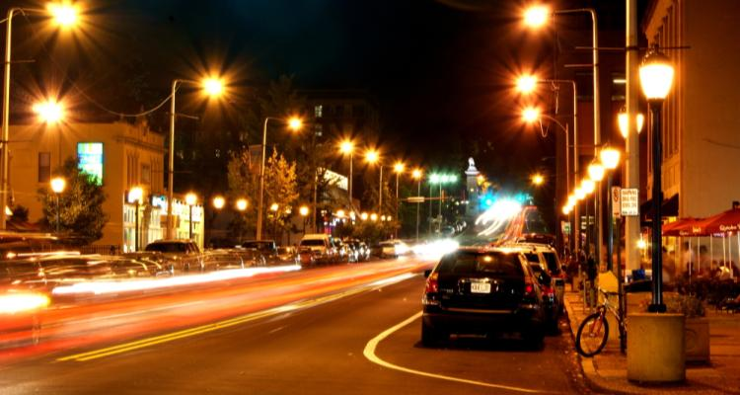
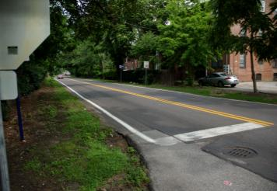
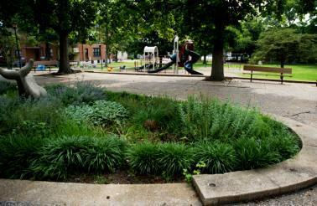
OBJECTIVE
HUD-DOT PARTNERSHIP FOR SUSTAINABLE COMMUNTIES LIVABILITY PRINCIPLES
The City of University City, in partnership with Washington University, the Parkview Gardens Association, Great Rivers Greenway, Trailnet, RHCDA, and others, developed a grant proposal entitled “Parkview Gardens: A Sustainable and Accessible Community” for a HUD-DOT Partnership for Sustainable Communities grant. This grant was applied for as part of the recommended implementation strategies in the Parkview Gardens Parks and Open Space Plan.
On October 20, 2010, University City was notified of their receipt of a grant award to complete this planning process. This planning process is one of the early-action implementation items specified in the Parkview Gardens Parks and Open Space Plan, adopted by the University City City Council on February 22, 2010.

Slide 6
OBJECTIVE
Parkview Gardens is a neighborhood with high potential for sustainable development, but it has a number of needs. University City’s goal, and the overall project objective, is a connected and inclusive Parkview Gardens neighborhood where housing, infrastructure, open space, and economic development strategies complement existing and planned public transportation resources to increase long-term community and environmental sustainability.

Slide 7
PARTNERS
The City of University City
Washington University In St. Louis
The Parkview Gardens Association
Great Rivers Greenway District
Trailnet
Regional Housing and Community Development Alliance
Arcturis
St. Louis Regional Arts Commission
The City of St. Louis
ADVISORS
Gateway Foundation
Metro
University City Arts and Letters Commission
University City Parks Commission

Slide 8
LEVERAGING & COLLABORTATION
CASH
The City of University City $15,000
Washington University In St. Louis $50,000
The Parkview Gardens Association $25,000
Great Rivers Greenway District $10,000
IN-KIND CONTRIBUTIONS
The City of University City $21,385
Washington University In St. Louis $149,180
RHCDA $13,600
St. Louis Regional Arts Commission $10,500
Arcturis $10,048
The Parkview Gardens Association $5,000
Gateway Foundation $3,600
Great Rivers Greenway District $2,500
Trailnet $2,000
TOTAL LEVERAGE $317,813
GRANT AWARD $315,687
TOTAL COST: $633,500

Slide 9
CONSULTANTS
H3 Studio Prime Planning Consultant
Development Strategies Economic Development Sub-consultant
David Mason & Associates Engineering Sub-consultant
CH2M Hill Circulation and Parking Sub-consultant
Trailnet Bike/Walk Sub-consultant
501 Creative Communication & Marketing
RHCDA Evaluation & Outcome Measurement

Slide 10
SCOPE OF SERVICES
1.0 SITE INVESTIGATION
Analysis at Two (2) Scales
Parkview Gardens Park Site Surveys
Stakeholder Interviews
2.0 GUIDING LIVABILITY PRINCIPLES
Draft Vision, Goals, and Sustainability/Livability Principles
PPP Committee Meeting 01/Public Workshop 01
Refinement of Vision, Goals, and Sustainability/Livability Principles
3.0 ENVISIONING A SUSTAINABLE FUTURE
Parkview Gardens Sustainable Development Plan Options
Preliminary Economic Development Assessment
Parkview Gardens Parks Schematic Design
PPP Committee Meeting 02/Public Workshop 02
4.0 DRAFT SUSTAINABLE DEVELOPMENT PLAN
Preferred Option Sustainable Development Plan
Refinement of Economic Development Assessment
Preliminary Integrated Funding Plan
Parkview Gardens Parks 30% Design Development
PPP Committee Meeting 03/Public Workshop 03
5.0 FINAL SUSTAINABLE DEVELOPMENT PLAN
Draft Neighborhood Sustainable Development Plan
Refinement of Integrated Funding Plan
Parkview Gardens Parks 50% Design Development
PPP Committee Meeting 04/Public Workshop 04
Final Neighborhood Sustainable Development Plan
Final Public Presentation

Slide 11
KEY WORK PRODUCTS
Neighborhood Sustainable Development Plan
Open Space Plan
Development Program
Form-Based Recommendations
Urban Sustainability Systems
Vehicular Access, Traffic, and Parking Design
Integrated Funding Plan
Fifty-Percent (50%) Design Development Documents for Metcalfe Park and Ackert Park
Ackert Walkway Conceptual Design (by Washington University Sam Fox School of Design)
Neighborhood Housing Design Prototypes (by Washington University Sam Fox School of Design)

Slide 12
PROJECT SCHEDULE
February 21, 2011: Notice to Proceed
February 26: Trailnet Bike/Walk Audit
February 21 –
April 29: H3 Studio Neighborhood Analysis
ARCH 657: Contemporary Practices in Sustainable Urbanism
ARCH 454: Public Space and City Life
March 26: Community Workshop
Public Space and City Life – Ackert Walkway Case Studies
June 8: PPP Committee Meeting/ Public Workshop 01:
Defining Livability – A Public Workshop on Sustainable Living
August 30: PPP Committee Meeting/ Public Workshop 02:
Exploring Housing and Parks in Parkview Gardens

Slide 13
PROJECT SCHEDULE (cont.)
September 22: PPP Committee Review Session, Phase 3.0
October 5: Plan Commission Presentation 01
November 9: PPP Committee Meeting/ Public Workshop 03 – Sustainable Development Plan Preferred Option
Week of December 5: PPP Committee Review Session, Phase 4.0
Week of January 16, 2012: PPP Committee Meeting/ Public Workshop 04 – Draft Sustainable Development Plan
January 25: Plan Commission Presentation 02
February 13: City Council Work Session
Week of February 20: Final Public Presentation – Parkview Gardens Sustainable Development Plan
March 26: Final Plan Commission Presentation

Slide 14
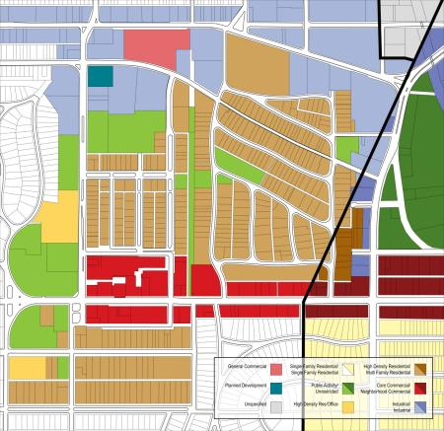
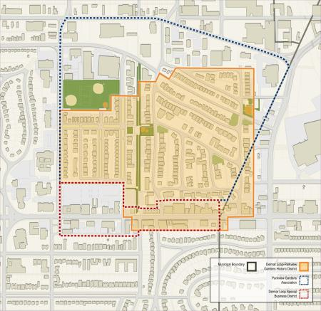
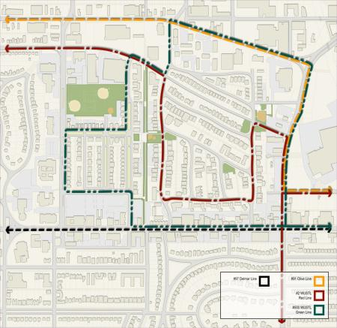

Slide 15
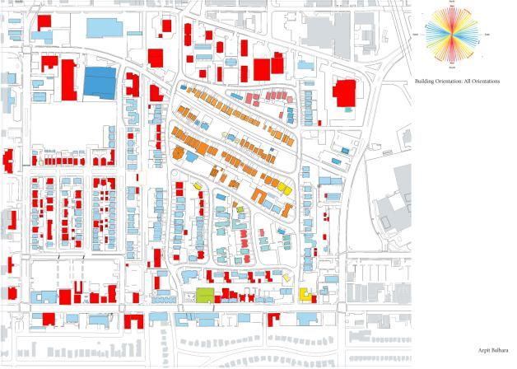
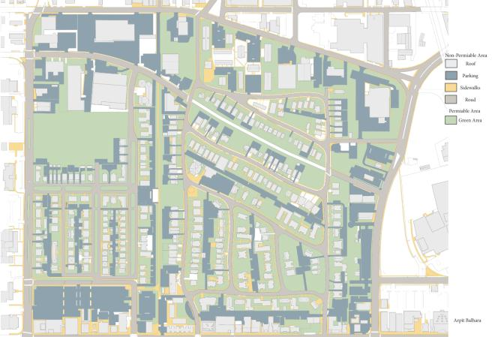
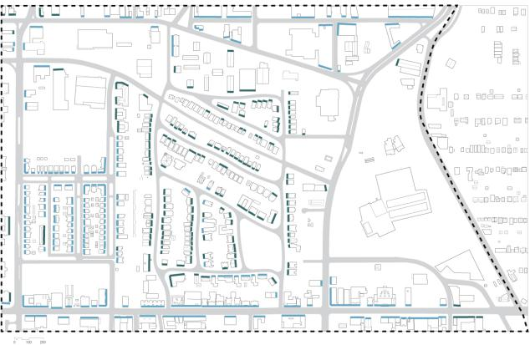
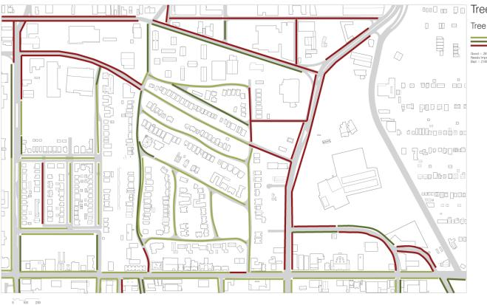

Slide 16
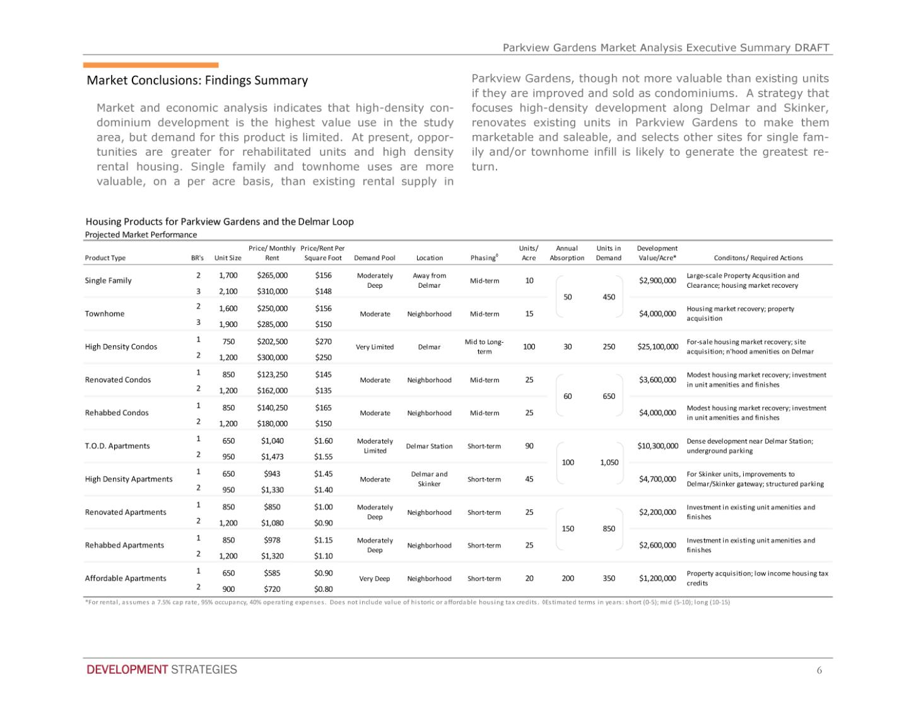

Slide 18
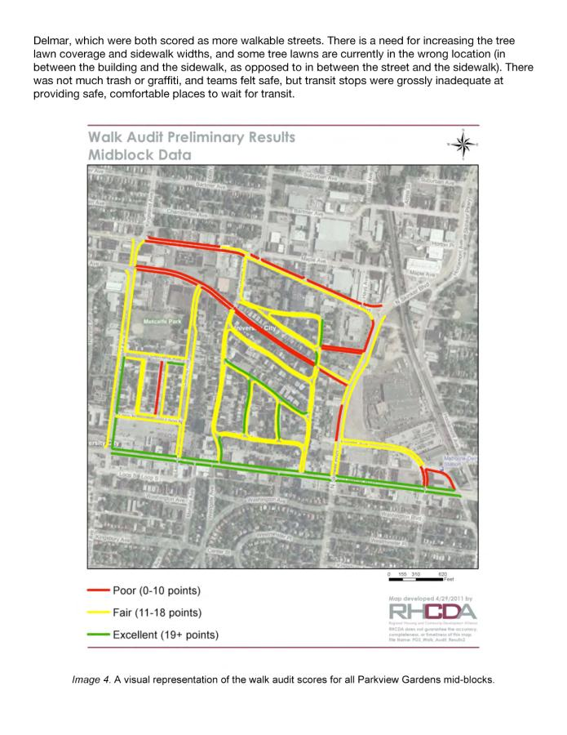

Slide 19
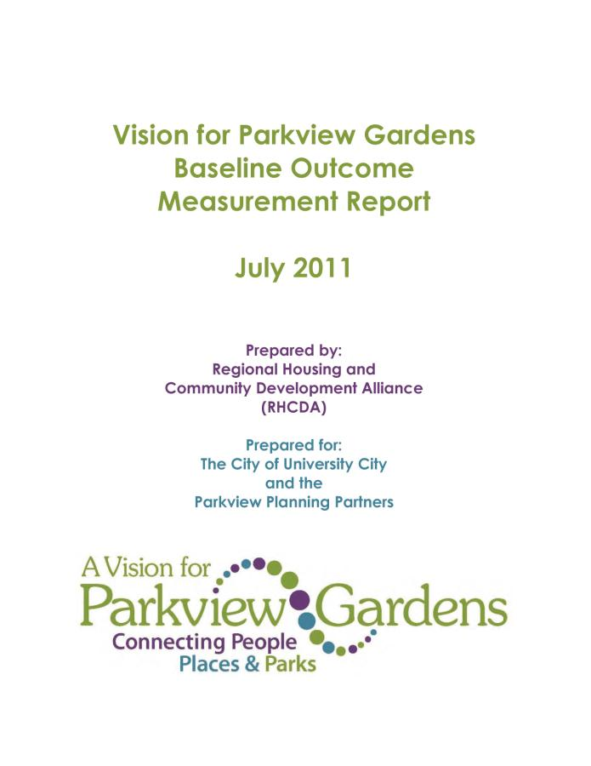
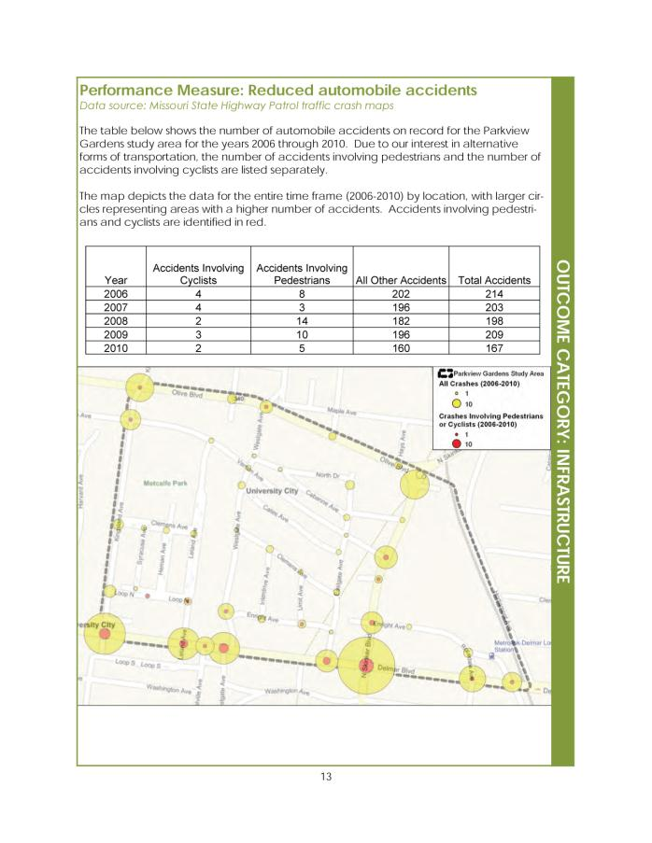

Slide 20
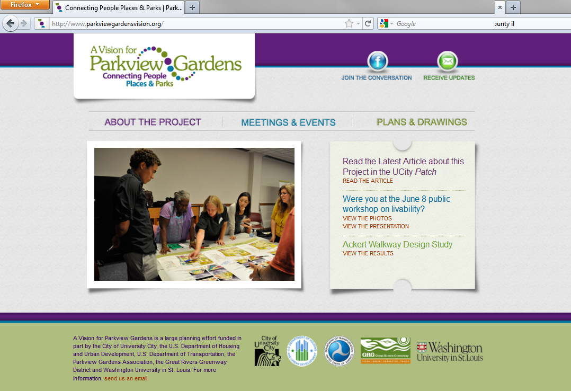
PROJECT WEBSITE: http://www.parkviewgardenvision.org/

Slide 21
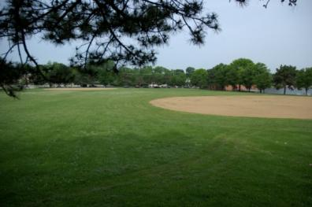
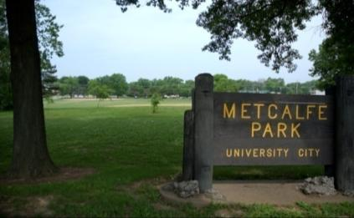
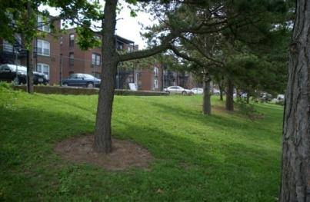
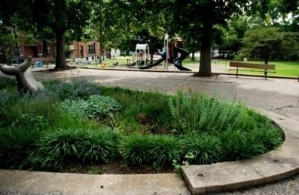
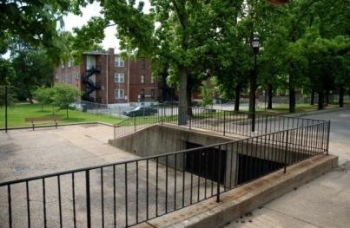
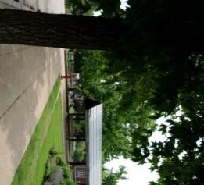
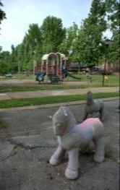
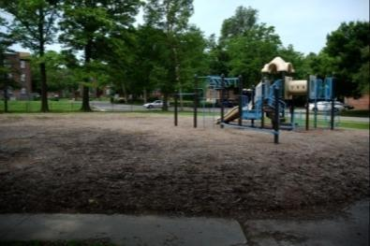
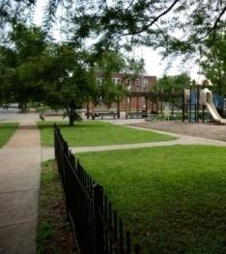
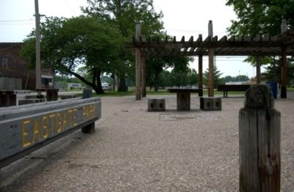
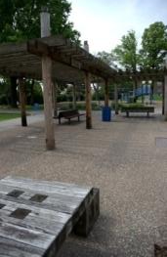
PUBLIC WORKSHOP #1 SUMMARY

Slide 22
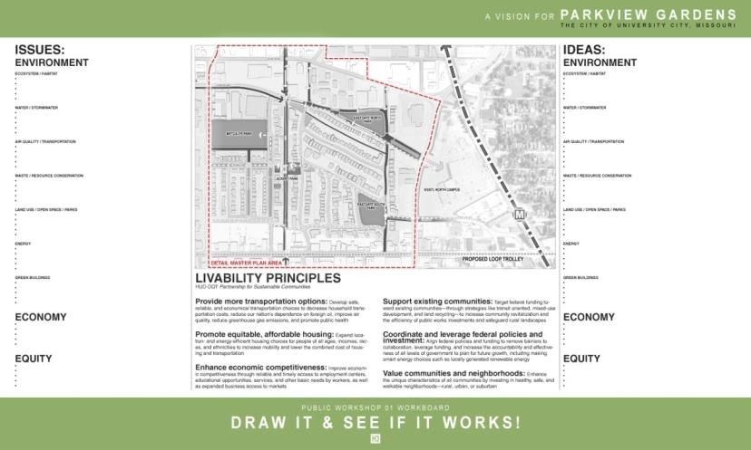
PUBLIC WORKSHOP
#1 SUMMARY:
Process
Invited residents and community members to participate in identifying the important issues of livability in Parkview Gardens. With a presentation on the Parkview Gardens Park Plan and an introduction to Sustainable Urban Strategies, participants used markers on a neighborhood map to illustrate concerns and ideas for the neighborhood.
Goals
Develop a list of issues and ideas
Cross check issues and ideas with HUD
Livability Principles
Draw your ideas on the map

Slide 23
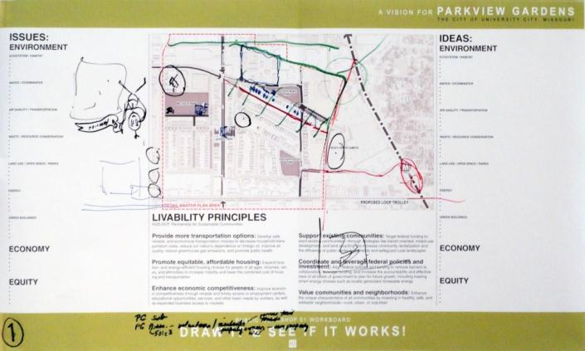
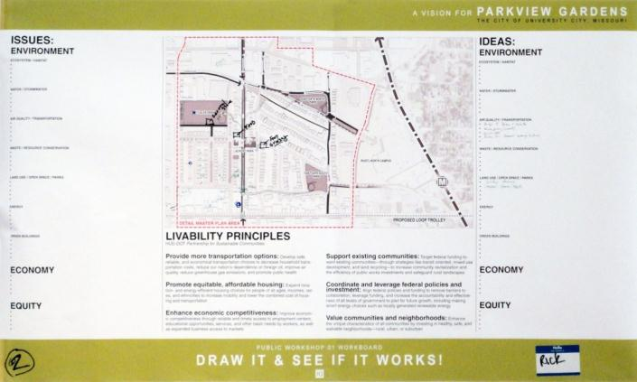
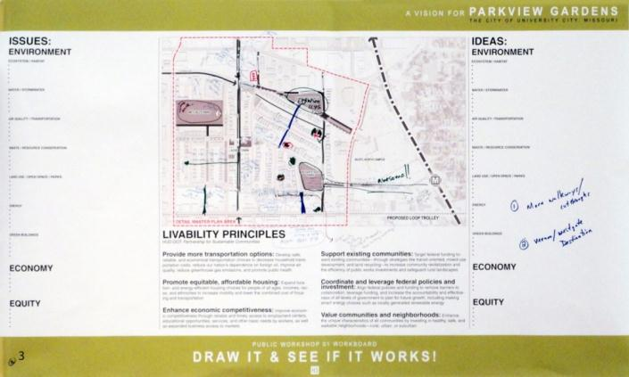
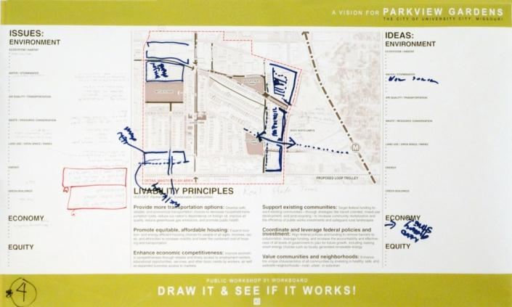

Slide 24
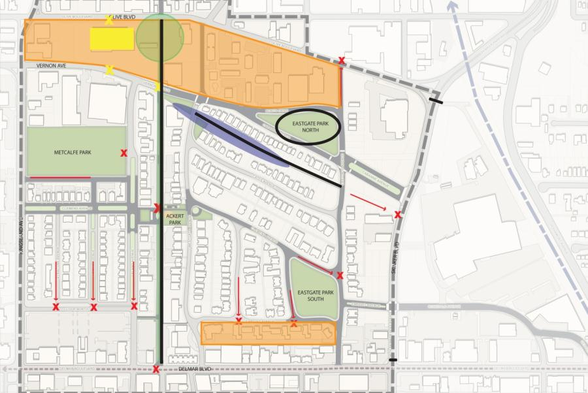
SUMMARY ISSUES:
Poor pedestrian connectivity through the neighborhood to parks, major streets, and Metrolink.
Ackert Walkway lacks a destination, and needs improvement of surrounding alleys, green spaces, and safety.
The study area has some buildings and blocks that differ from the neighborhood typology in scale, function, and building type including warehouses, vacant buildings, and some housing.
Neighborhood lacks a walk-able grocery store and needs increased diversity of food options.
Flooding, stormwater runoff, and smelly sewers highlight problems with drainage and stormwater management.
Some areas of the neighborhood are perceived as unsafe, including public parks and green spaces.

Slide 25
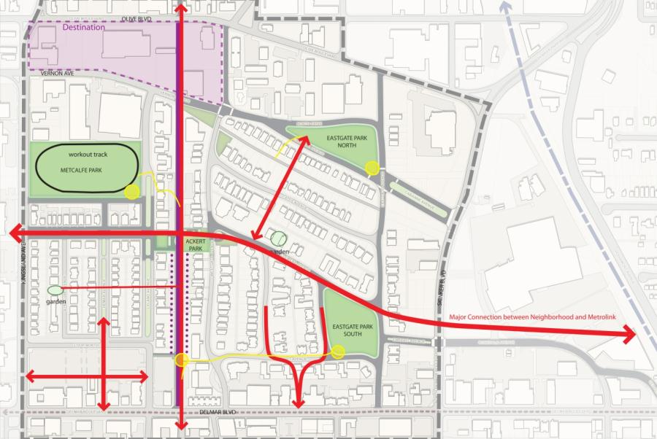
SUMMARY IDEAS:
Increase connectivity from the neighborhood to Metrolink station across Skinker
Increase connectivity through long Delmar blocks into the neighborhood, similar to how Ackert Walkway works
Create improved connections between parks, green spaces, and residences
Clear bike paths and nodes connecting parks and residential blocks though the neighborhood
Remove dumpsters from, create art spaces along edges of, increase visibility to, and develop water features along Ackert Walkway.
Reprogram Metcalfe Park with a workout loop, playground improvements, water features, a dog park, more shaded areas, an outdoor theater, and water/stormwater gardens to help decrease flooding

Slide 26
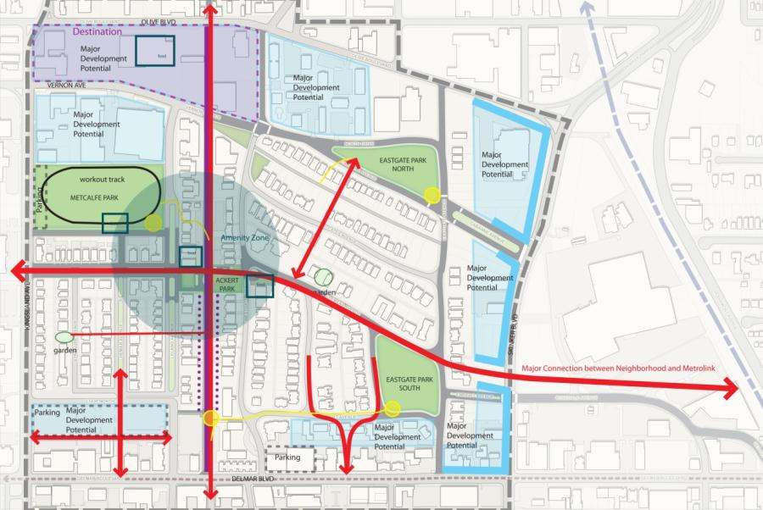
SUMMARY IDEAS:
Remove/reuse ‘ugly’ or outdate buildings are remove/reprogram buildings that are not functioning in neighborhood like warehouses and vacant buildings
Preserve neighborhood architectural heritage like historic buildings, building materials, quality, and craftsmanship.
Develop grocery stores or a general store or more food options throughout the neighborhood
Increase number of community gardens or small scale green spaces
Increase home ownership possibly with condos
Increase participation in neighborhood associations
Implement incentives for green building technologies like solar panels, solar water heaters, and green roofs

Slide 27
PUBLIC WORKSHOP #2 SUMMARY

Slide 28
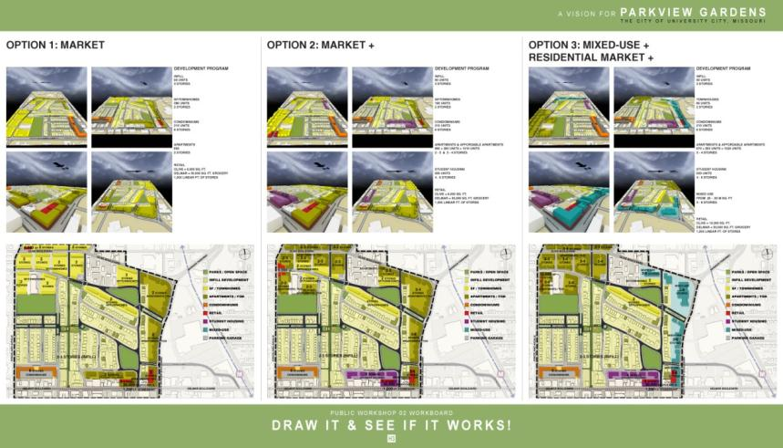
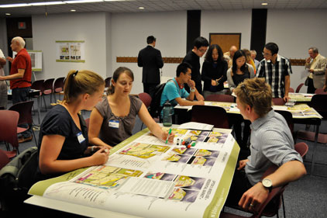
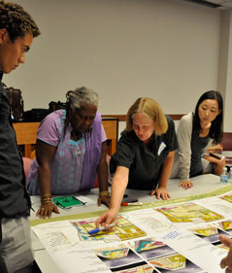
PUBLIC WORKSHOP
# 2 SUMMARY:
Based on the Market Analysis conducted by Development Strategies, H3 Studio developed 3 Neighborhood Development Plan and Massing Options. These options were: Residential Market (requiring little to no subsidy, as supported by the Market Analysis); Residential Market + (including the non-market based products of Affordable and Student Housing, which will require subsidy); and Mixed-Use + Residential Market +, which included other non-residential uses and programs in addition to the Residential Market.
These Options were presented to the public at Public Workshop #2 on August 30, 2011. While there were specific issues raised by the community regarding neighborhood retail sites, accessibility, and adequate parking, the community consensus for a preferred option was overwhelmingly for Mixed-Use + Residential Market +.

Slide 29
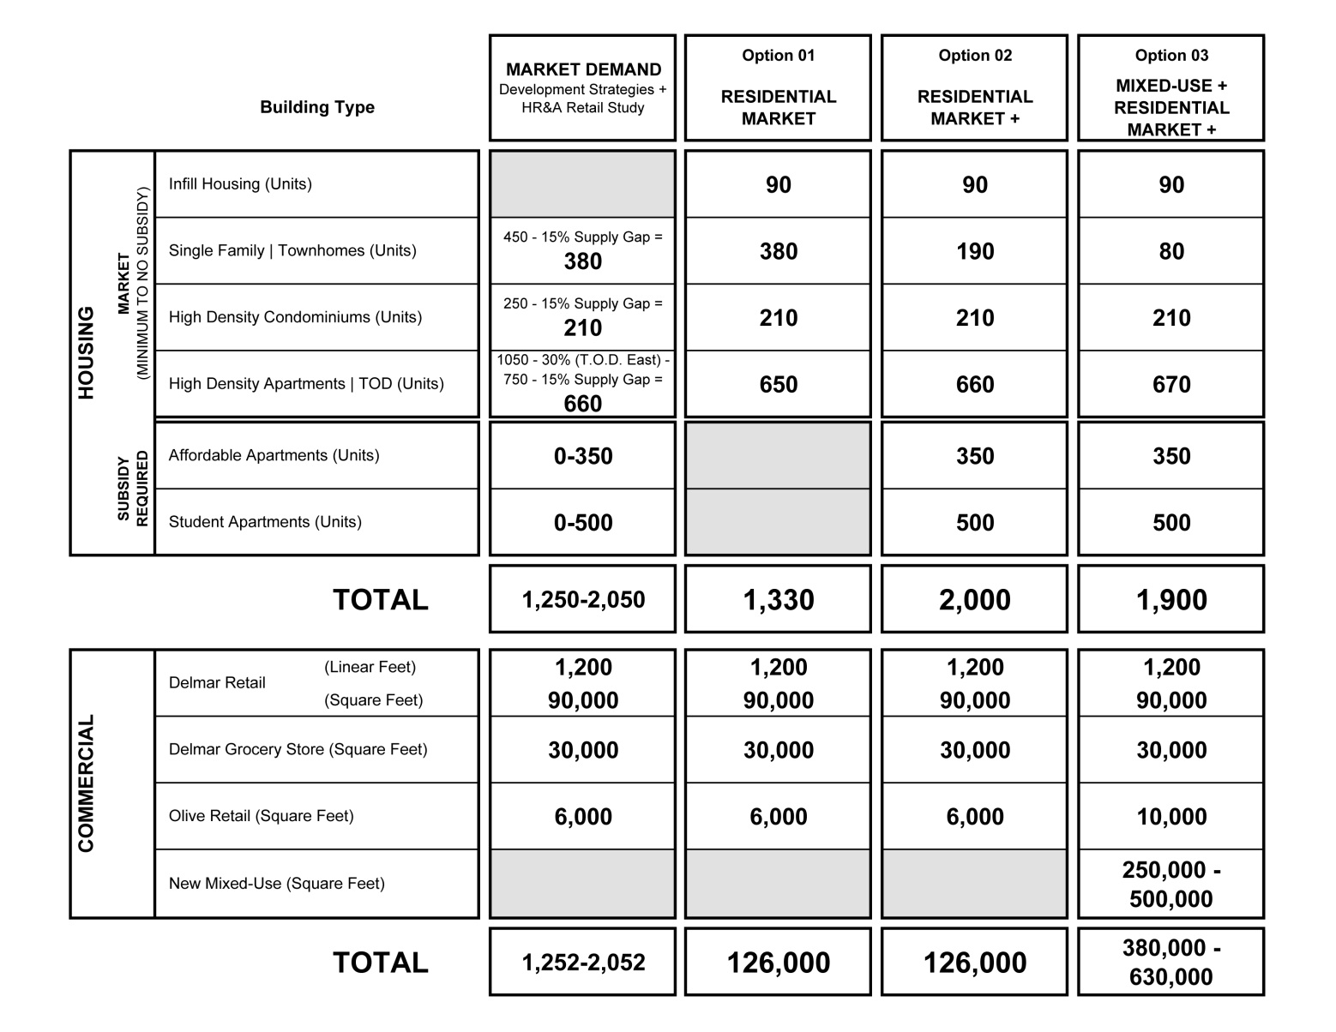
MARKET DEMAND

Slide 30
PREFERRED OPTION:
MIXED-USE + RESIDENTIAL MARKET +

Slide 31
VISION STATEMENT
Parkview Gardens will become University City’s premier Transit-Orientated Sustainable Neighborhood by building upon its rich history, unique assets of buildings and parks, the arts, culture and entertainment corridor of THE LOOP, and its adjacency to University City’s Civic Center, Washington University North Campus, and adjacent business parks and neighborhoods

Slide 32
NEIGHBORHOOD SUSTAINABILITY GOALS
Revitalize as a Transit Oriented Neighborhood by providing more transportation options and creating active pedestrian networks to reduce household transportation cost, reduce environmental impact of personal mobility, increase access to neighborhood amenities, build community identity, and promote public health.
Build upon existing community qualities and characteristics to bolster community revitalization and build diversity by leveraging public amenities like historic architecture, parks, signature cultural and retail establishments, and a growing arts and education community.
Expand existing Arts, Culture, and Education assets, programs, and amenities by building a community network of physical and human resources to establish the neighborhood as a unique cultural district.
Increase local business and job opportunities by growing a diverse job market and promoting innovation and creative industries as part of a growing creative cultural area with easy access to educational opportunities, services, and basic worker amenities.
Promote community amenities, diversity and housing affordability by expanding housing and transportation choices for people of all ages, incomes, races, and ethnicities and creating equitable access to neighborhood resources like libraries, schools, and parks.
Build neighborhood capacity to positively impact environmental systems by building programs and networks that promote recycling, energy use reduction, water cleanliness and conservation, waste management, and habitat preservation.

Slide 33
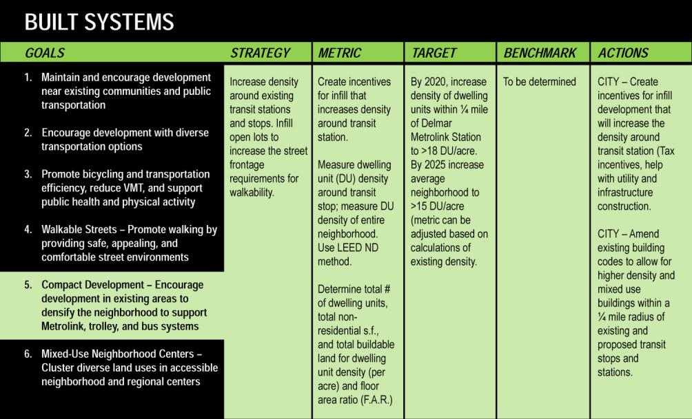
SUSTAINABILITY:
ENVIRONMENT
Natural Systems
Built Systems
Socio-Political & Legal Systems
Air Quality
Water
Energy
Food
Waste
Transportation / Mobility
Public Safety / Communications
ECONOMY
Population Growth / Shrinkage
Home Ownership / Rental
Employment Opportunities
Tax Base System & Income
Economic Development Tools
Land Ownership
EQUITY (SOCIAL)
Diversity of Population
Urban Quality & Public Space Network
Universal Accessibility
Public Health
Public Services / Amenities
Livability

Slide 34
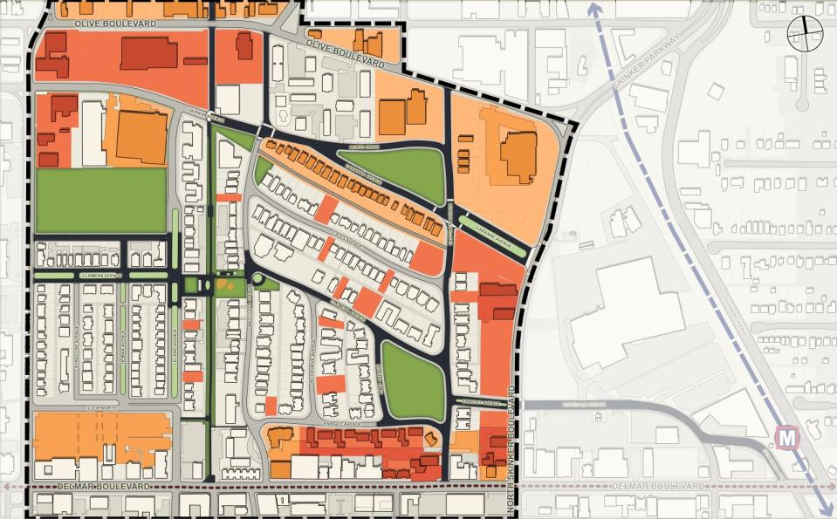
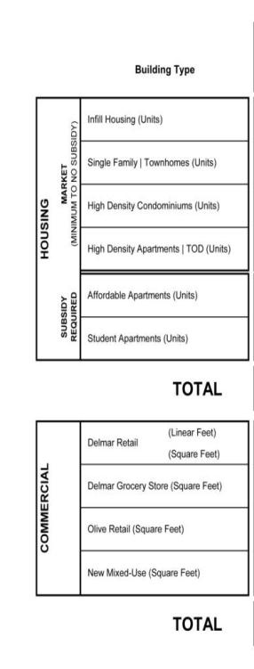
DEVEVELOPMENT FRAMEWORK
The PREFERRED OPTION PLAN integrates transportation, development market, and land use into a unified plan.

Slide 35
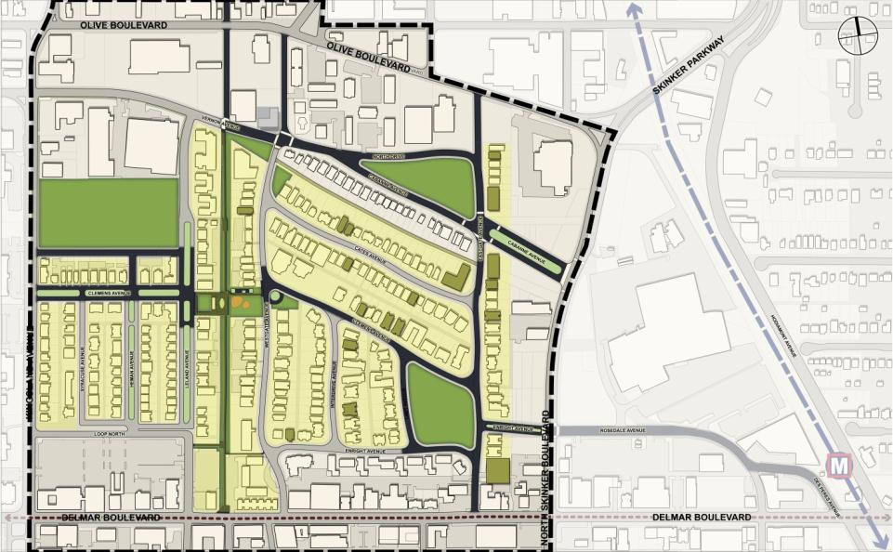
MIXED USE +
R - MARKET+
FRAMEWORK PLAN
INFILL HOUSING
90 units (3 stories)

Slide 36
MIXED USE +
R - MARKET+
FRAMEWORK PLAN
INFILL HOUSING
TOWNHOMES
80 units (2 stories)

Slide 37
MIXED USE +
R - MARKET+
FRAMEWORK PLAN
INFILL HOUSING
TOWNHOMES
CONDOMINIUMS
210 units (6 stories)

Slide 38
MIXED USE +
R - MARKET+
FRAMEWORK PLAN
INFILL HOUSING
TOWNHOMES
CONDOMINIUMS
APARTMENTS &
AFFORDABLE APT’s.
670 units + 350 units
(3-4 stories)

Slide 39
MIXED USE +
R - MARKET+
FRAMEWORK PLAN
INFILL HOUSING
TOWNHOMES
CONDOMINIUMS
APARTMENTS &
AFFORDABLE APT’s.
STUDENT HOUSING
500 units (4-5 stories)

Slide 40
MIXED USE +
R - MARKET+
FRAMEWORK PLAN
INFILL HOUSING
TOWNHOMES
CONDOMINIUMS
APARTMENTS &
AFFORDABLE APT’S.
STUDENT HOUSING
MIXED USE
From 0.25 - 0.5M sq. ft.
(3-6 stories)
RETAIL On Olive:
10,000 sq. ft
RETAIL On Delmar:
30,000 sq. ft grocery & 1,200 linear ft. of stores

Slide 41
MIXED USE +
R - MARKET+
FRAMEWORK PLAN
INFILL HOUSING
TOWNHOMES
CONDOMINIUMS
APARTMENTS &
AFFORDABLE APT’S.
STUDENT HOUSING
MIXED USE

Slide 42
MIXED USE +
R - MARKET+
EXISTING
Delmar looking north

Slide 43
MIXED USE +
R - MARKET+
PROPOSED
Delmar looking north

Slide 44
MIXED USE +
R - MARKET+
EXISTING
Delmar/Skinker intersection

Slide 45
MIXED USE +
R - MARKET+
PROPOSED
Delmar/Skinker intersection

Slide 46
MIXED USE +
R - MARKET+
EXISTING
Skinker looking west

Slide 47
MIXED USE +
R - MARKET+
PROPOSED
Skinker looking west

Slide 48
MIXED USE +
R - MARKET+
EXISTING
Kingsland looking east

Slide 49
MIXED USE +
R - MARKET+
PROPOSED
Kingsland looking east

Slide 50
MIXED USE +
R - MARKET+
SUMMARY
EX. & INFILL HOUSING
90 units (3 stories)
TOWNHOMES
80 units (2 stories)
CONDOMINIUMS
210 units (6 stories)
APARTMENTS & AFFORDABLE APTS.
670 + 350 units (3-4 stories)
STUDENT HOUSING
500 units (4-5 stories)
MIXED USE
0.25-0.5M sq. ft. (3-6 stories)
RETAIL
Olive = 10,000 sq. ft.
Delmar = 30,000 sq. ft. grocery & 1,200 linear ft. of stores

Slide 51
NEXT STEPS…
Develop the Draft Neighborhood Sustainability Plan
Create the Thirty-Percent (30%) Design Development drawings for Metcalfe Park and Ackert Park
Present the Draft Neighborhood Sustainability Plan to the Parkview Planning Partners and the community in Public Workshop 03 on November 9, 2011
Continue to work and coordinate with University City and City of St. Louis staff and community stakeholders

Slide 52
PROJECT WEBSITE: http://www.parkviewgardenvision.org/

Slide 53
PROJECT CONTACT:
Raymond Lai, AICP
Deputy Director – Planning, Zoning & Economic Development
Department of Community Development
City of University City
(t) 314.505.8502 (f) 314.862.3168
rlai@ucitymo.org

Slide 55
Option 1
R - MARKET
SUMMARY
EX. & INFILL HOUSING
90 units (3 stories)
TOWNHOMES
380 units (2 stories)
CONDOMINIUMS
210 units (6 stories)
APARTMENTS/T.O.D.
650 units (2 stories)
RETAIL
Olive = 6,000 sq. ft.
Delmar = 30,000 sq. ft grocery & 1,200 linear ft. of stores

Slide 56
Option 2
R - MARKET +
SUMMARY
EX. & INFILL HOUSING
90 units (3 stories)
TOWNHOMES
190 units (2 stories)
CONDOMINIUMS
210 units (6 stories)
APARTMENTS & AFFORDABLE APTS.
660 + 350 units (2-3 & 3-4 stories)
STUDENT HOUSING
500 units (4-5 stories)
RETAIL
Olive = 6,000 sq. ft.
Delmar = 30,000 sq. ft grocery & 1,200 linear ft. of stores

Slide 57
Option 3/Preferred Option
MIXED USE +
R - MARKET+
SUMMARY
EX. & INFILL HOUSING
90 units (3 stories)
TOWNHOMES
80 units (2 stories)
CONDOMINIUMS
210 units (6 stories)
APARTMENTS & AFFORDABLE APTS.
670 + 350 units (3-4 stories)
STUDENT HOUSING
500 units (4-5 stories)
MIXED USE
0.25-0.5M sq. ft. (3-6 stories)
RETAIL
Olive = 10,000 sq. ft.
Delmar = 30,000 sq. ft. grocery & 1,200 linear ft. of stores

