Slide 1
Traffic Presentation
Delmar Improvements
Parking
Traffic Analysis

Slide 2
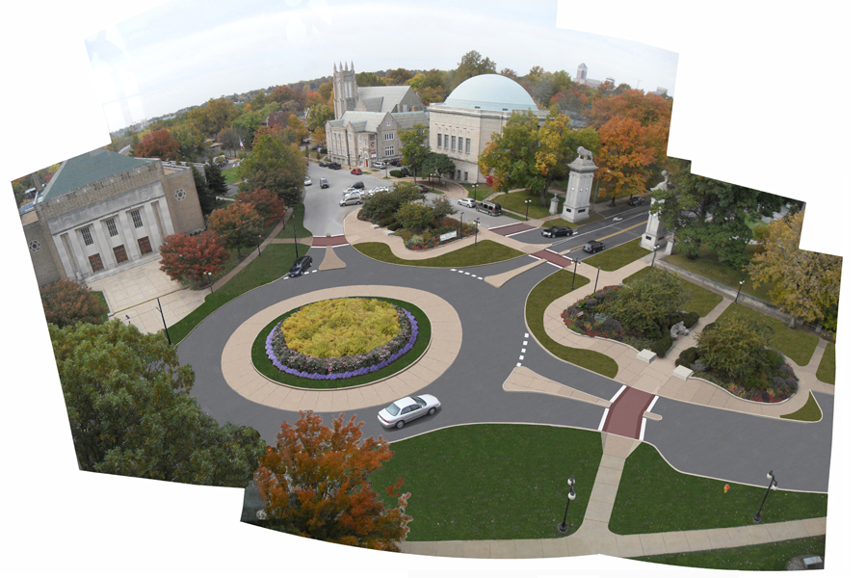
Delmar Improvements

Slide 3
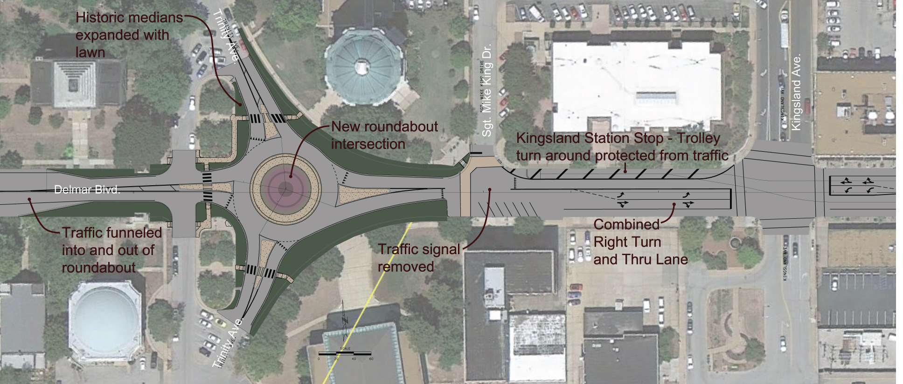
Delmar Improvements

Slide 4
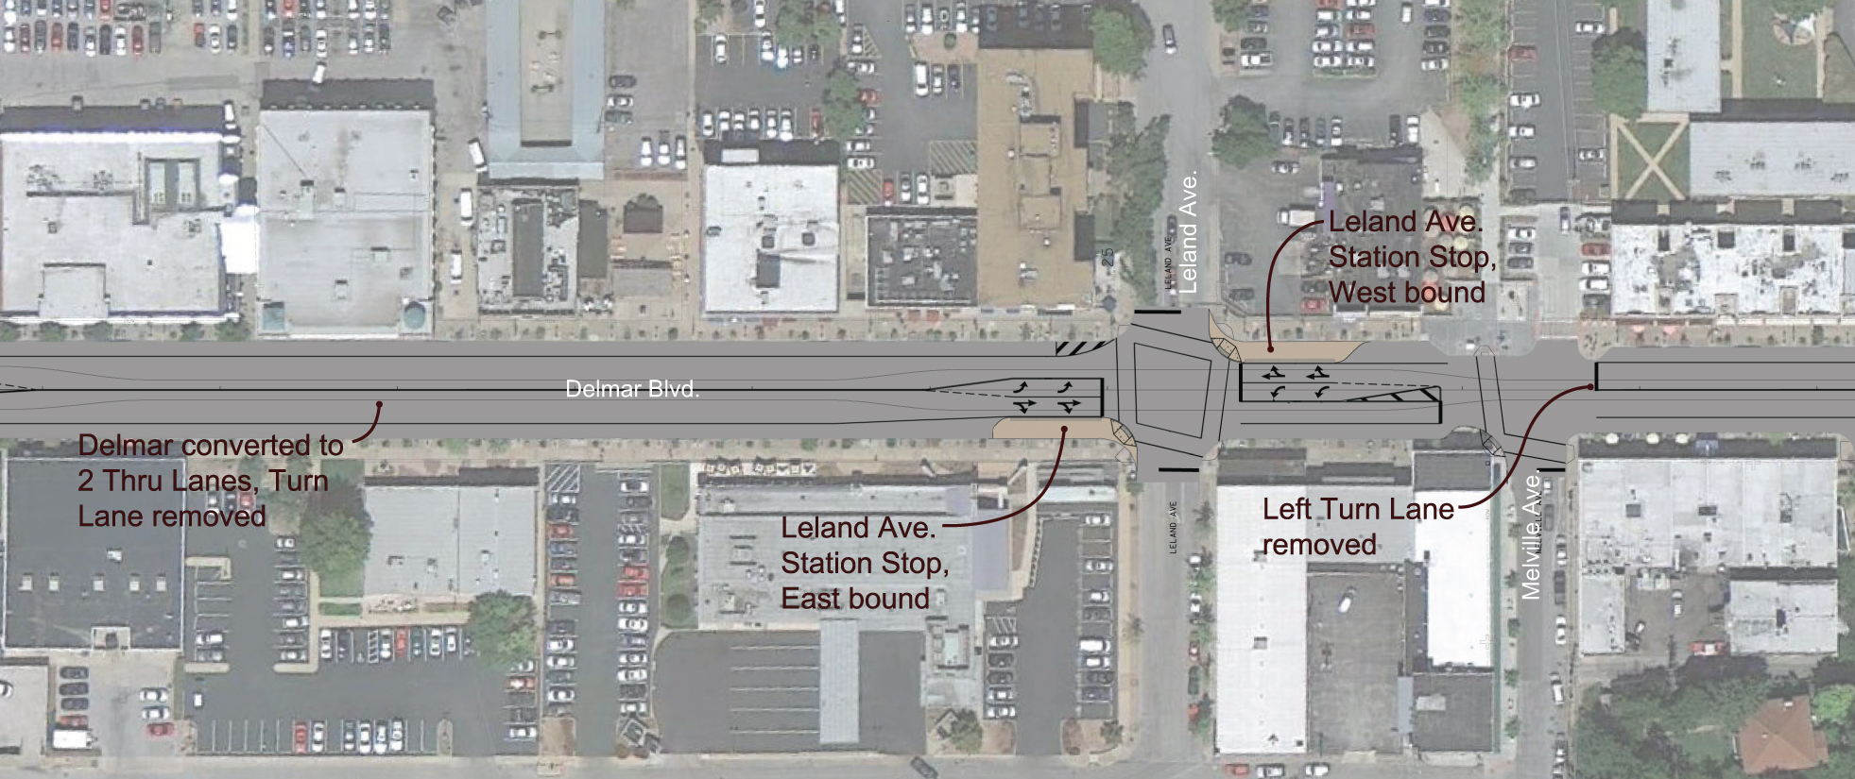
Delmar Improvements

Slide 5
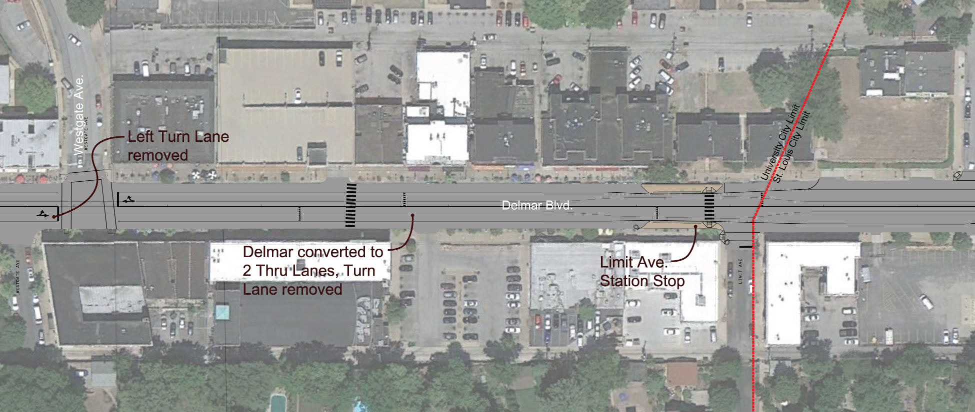
Delmar Improvements

Slide 6
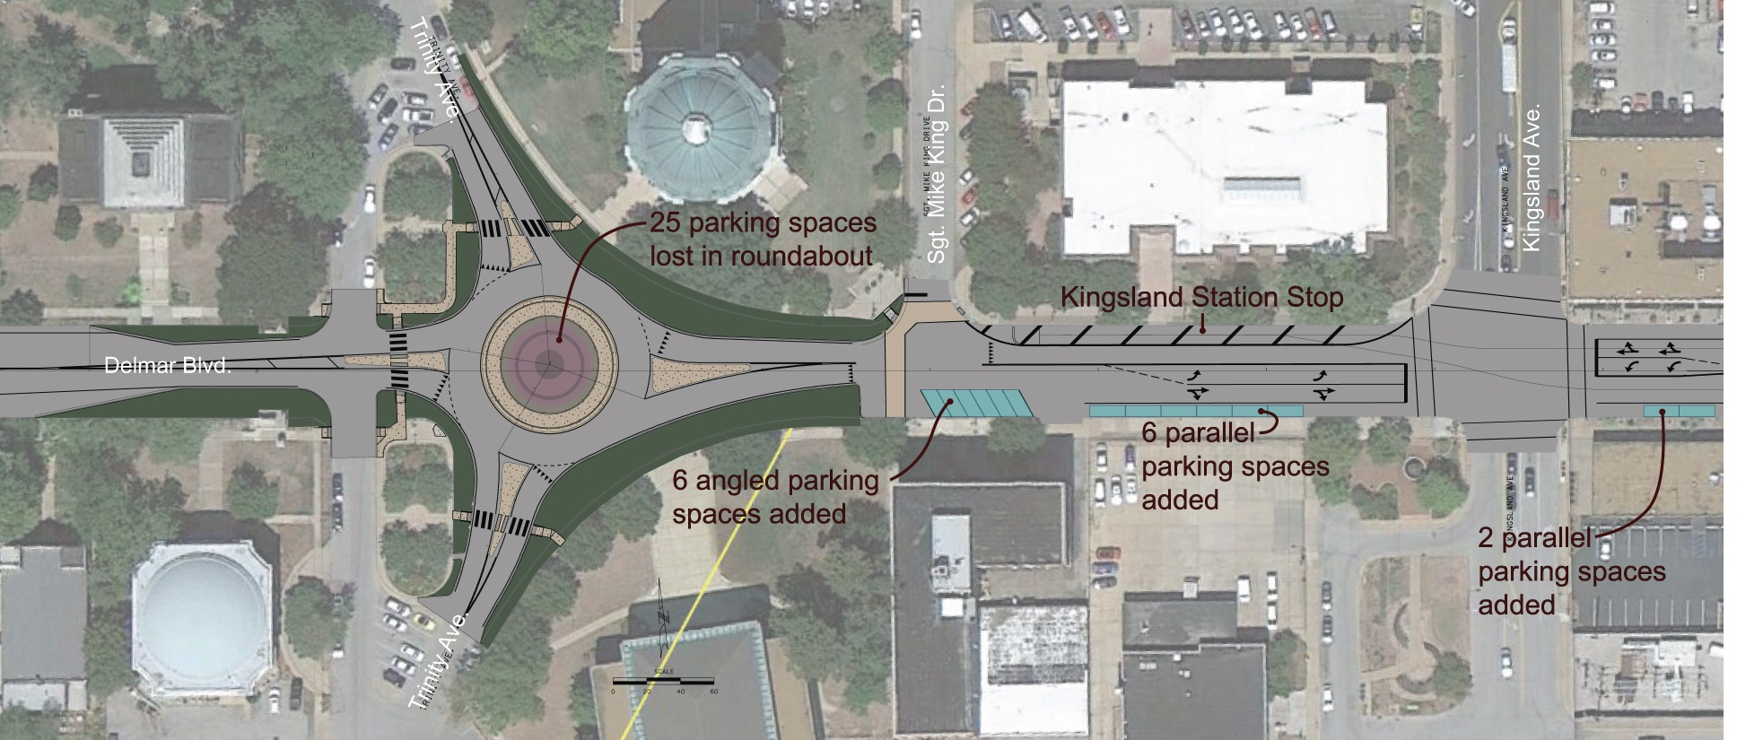
Parking

Slide 7
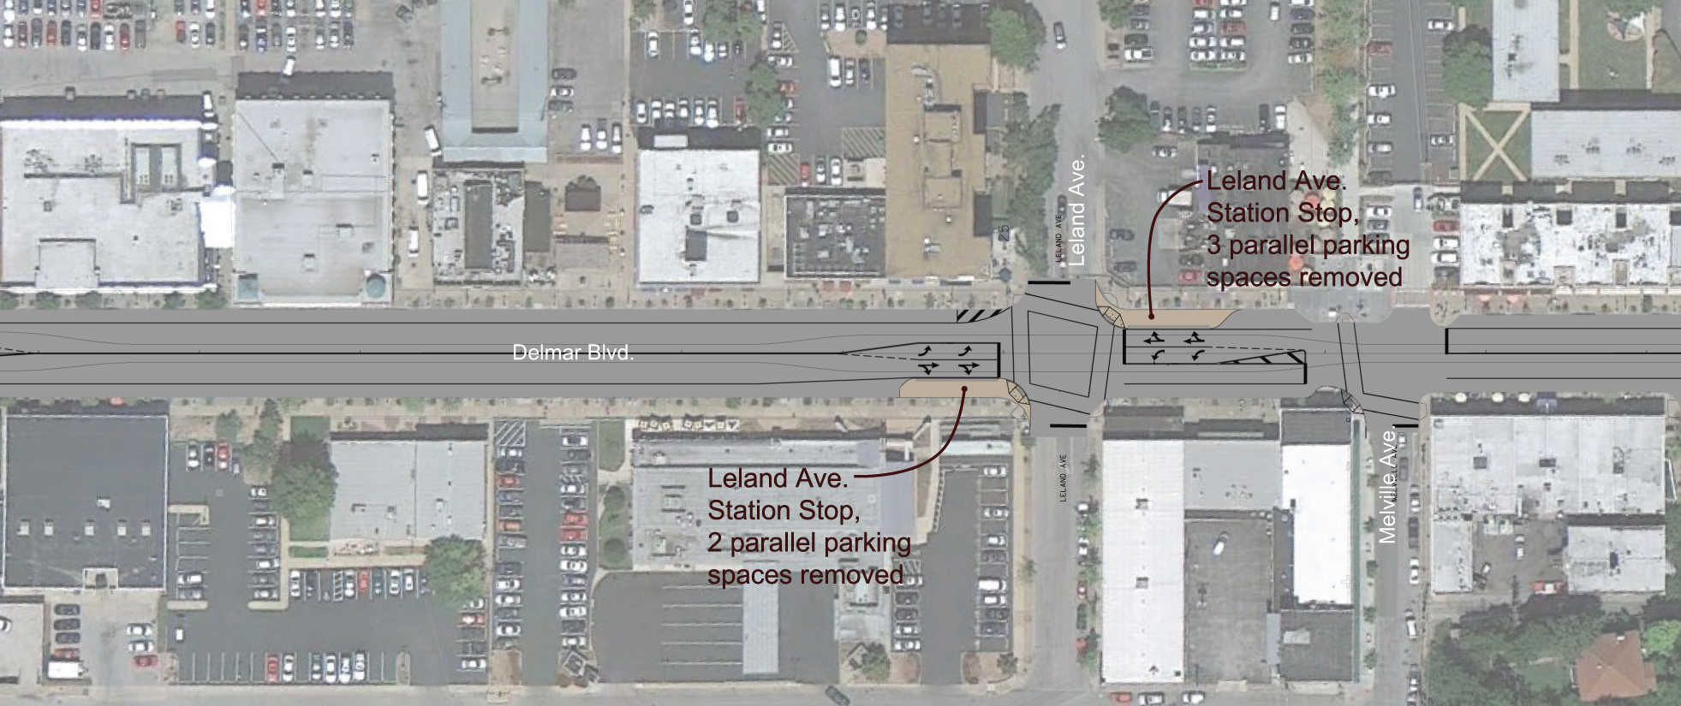
Parking

Slide 8
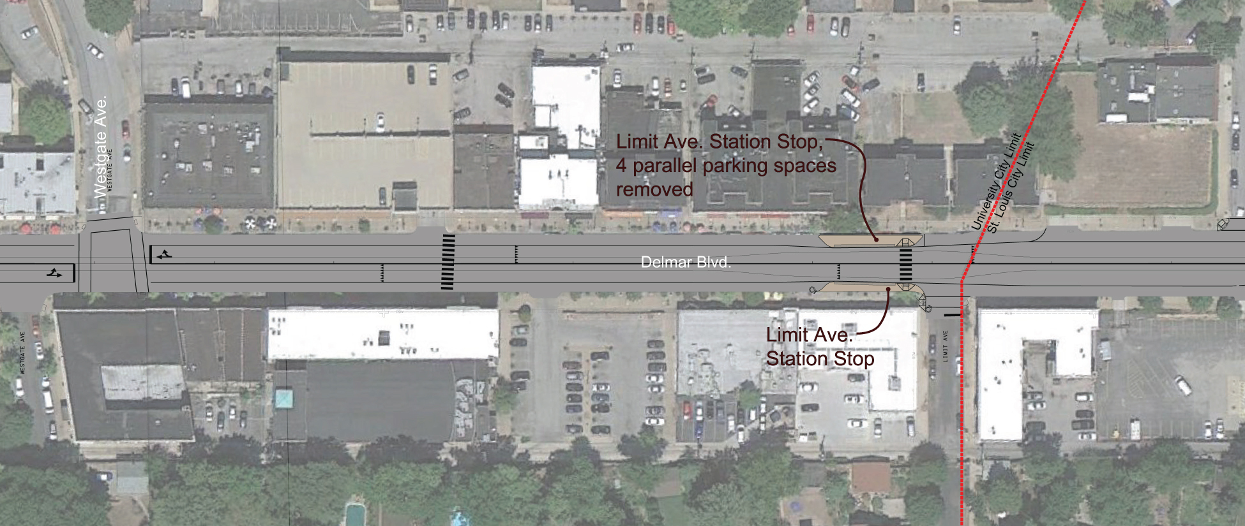
Parking

Slide 9
Traffic Analysis
Existing Condition Level of Service Table (2012)
Intersection | Level of Service
Trinity NB SB | F E
Sgt. Mike King | B
Kingsland | C
Leland | C
Melville | B
Westgate | B

Slide 10
Traffic Analysis
Future No Build Level of Service Table (2032)
Intersection | Level of Service
Trinity NB SB | F F
Sgt. Mike King | B
Kingsland | D
Leland | C
Melville | B
Westgate | B

Slide 11
Traffic Analysis
Future Build Level of Service Table (2012)
Intersection | Level of Service
Trinity EB WB NB SB | C A A A
Sgt. Mike King EB WB SB | A A F (D)
Kingsland | C
Leland | C
Melville | B
Westgate | B

Slide 12
Traffic Analysis
Future Build Level of Service Table (2032)
Intersection | Level of Service
Trinity EB WB NB SB | D B A A
Sgt. Mike King EB WB SB | A A F (D)
Kingsland | D
Leland | C
Melville | B
Westgate | B

Slide 13
Traffic Analysis
VISSIM MODEL

Slide 14
Conclusion
Questions?

